Slide 1
HudsonAlpha BioTrain Computational Bootcamp

Slide 2
Computer Setup
https://james-lawlor.github.io/biotrain-2023/
Setup Bash (FOR TODAY)
(Windows) Download Git BASH http://www.gitforwindows.org
(Mac) Included. Open the “Terminal” application. Type bash and hit enter.
We will walk through data download together as a group using commands from james-lawlor.github.io
Install R (FOR TOMORROW) https://cran.rstudio.com/
Install RStudio Desktop https://www.rstudio.com/products/rstudio/download/#download

Slide 3
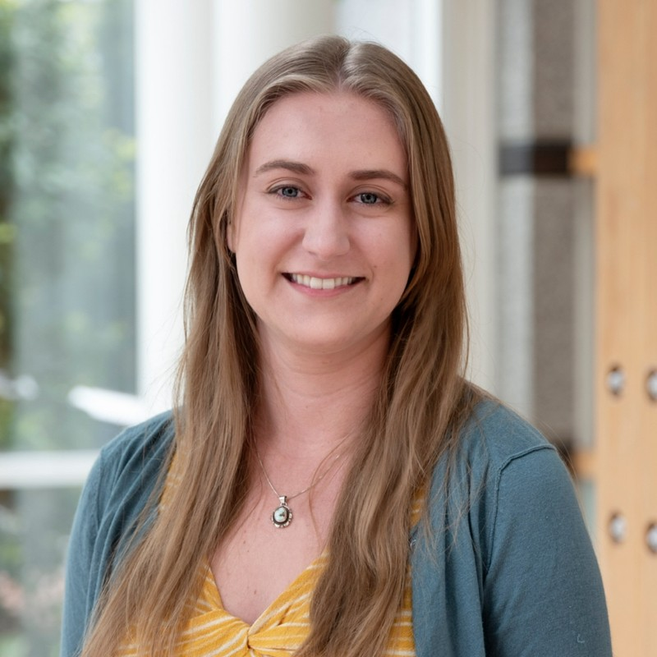
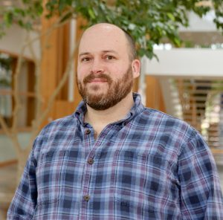
Your Instructors
James Lawlor, MS (he/him)
Computational Biologist, Greg Cooper Lab & Clinical Services Lab
Focus: Genomic Diagnoses
Ashlyn Anderson, MS (she/her)
Doctoral Student, Nick Cochran Lab
Focus: Neurobiology and Genomic Regulation

Slide 4
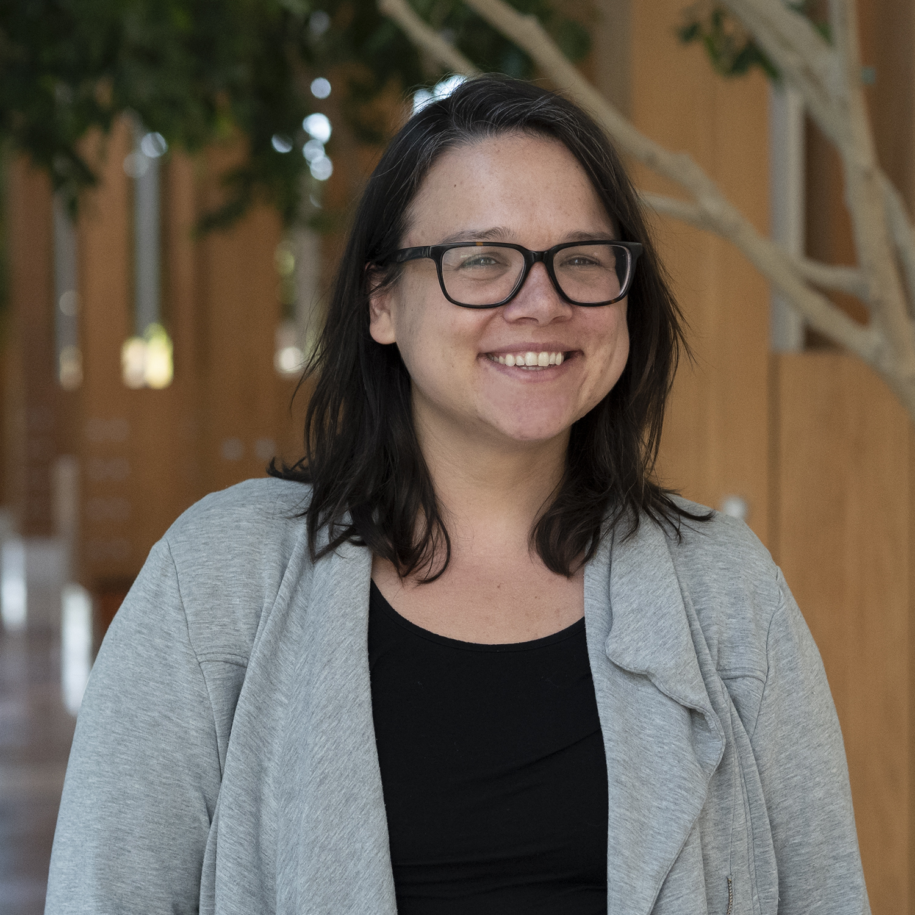
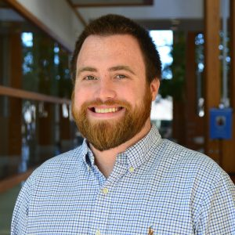
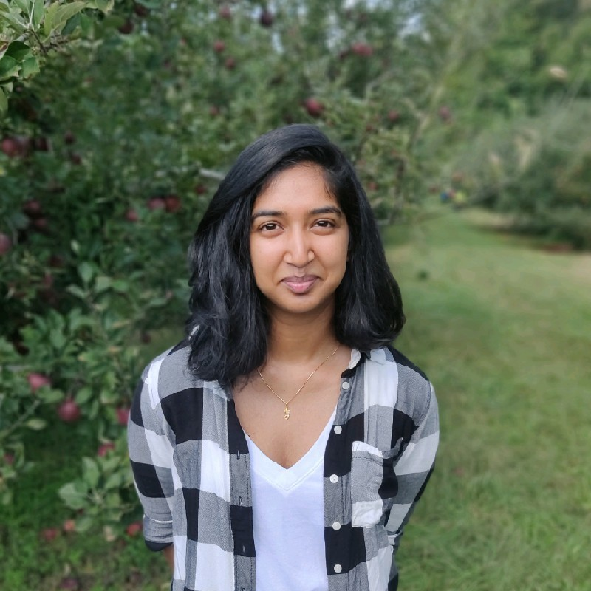
Your Helpers
Stephanie Felker, PhD
Jared Taylor, MS
Yokshitha Bathula, MS

Slide 5
Wednesday Agenda
What is Computational Biology?
Computational Biology in the Cooper Lab
Keeping a Computational Lab Notebook
Unix Fundamentals
Introducing the Shell
Navigating Files and Directories
Working With Files and Directories
Pipes, Filters, and Loops (brief overview of advanced topics)
Continued Learning: Where to go next?

Slide 6
Thursday Agenda
Computational Biology Examples from Stephanie Felker
Bootcamp Intro
Goals
Helpers & Post-Its
Why learn Unix & R?
Programming with R
Analyzing Biology Data
Writing Functions
Using For Loops to Analyze Multiple Data Sets
Getting Programming Help

Slide 7
Introduction to Biology with Computers
James Lawlor & Ashlyn Anderson

Slide 8
What is computational biology?
“Computational biology and bioinformatics is an interdisciplinary field that develops and applies computational methods to analyze large collections of biological data, such as genetic sequences, cell populations or protein samples, to make new predictions or discover new biology.” -- Nature.com

Slide 9
In other words…
Use computational tools
Programming
Mathematical models & machine learning
Databases
Physics simulations
To analyze huge sets of data
Genome sequencing
Protein modeling
And answer biological questions
How does this gene work?
Does this disease have a genetic pattern?
How are these species related?
What makes a liver cell different from a brain cell?

Slide 10
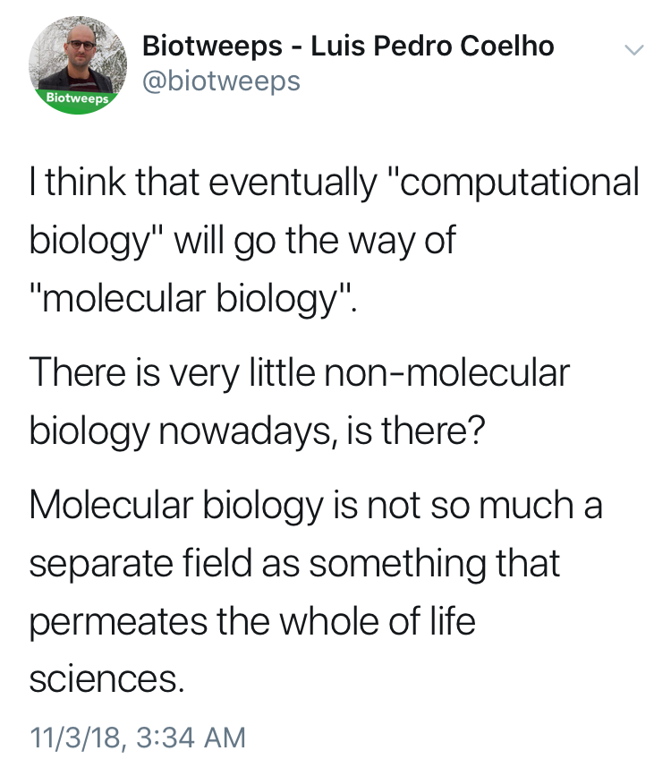

Slide 11
Terminology
The terms “bioinformatics” and “computational biology” are often used interchangeably:
Bioinformatics: Software tools, databases, visualization methods
Computational Biology: Data analysis, algorithm development, mathematical modeling
Other terms for the intersection of biology / math / computer science:
Data Science, Systems Biology, Statistical Biology, Biostatistics, Genomics (implicit), _____omics, Clinical Informatics, etc…

Slide 12
The bottom line:
Computational skills are increasingly critical for biology & many other fields
Hands-on experience is a huge first step

Slide 13

Solving Neurodevelopmental Disorders
James Lawlor
Computational Biologist: Greg Cooper Lab
Biotrain Bootcamp
May 29-30, 2024

Slide 14



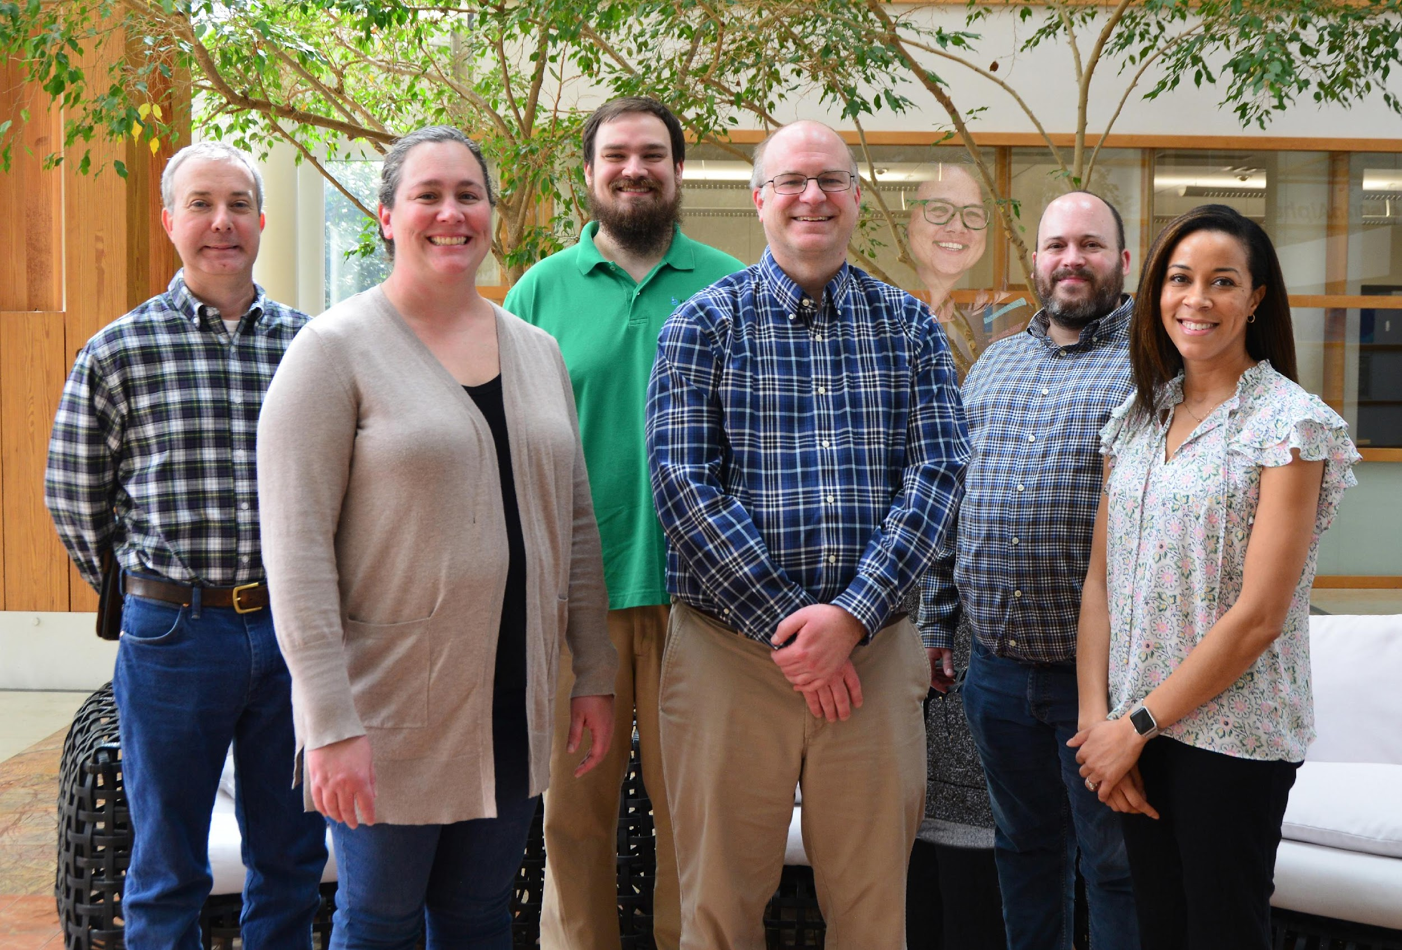

Greg Cooper Lab
Goal:
Identify genetic causes of neurodevelopmental diseases

Slide 15
Me
Background: Maryland -> Guntersville -> Huntsville
Undergrad:
Snead State CC (Boaz, AL): A.S. – Chemistry (2006-2008)
UAH:
B.S. Chemistry (ACS Biochemistry Track) & Mathematics (2008-2011)
grad classes + tutoring (2012)
Bonus: UAH Concert & Chamber Choir: 2008-2012
M.S Modeling & Simulation (CS dept): 2014-2017
Thesis: Using machine learning models to predict enhancers of CFTR

Slide 16
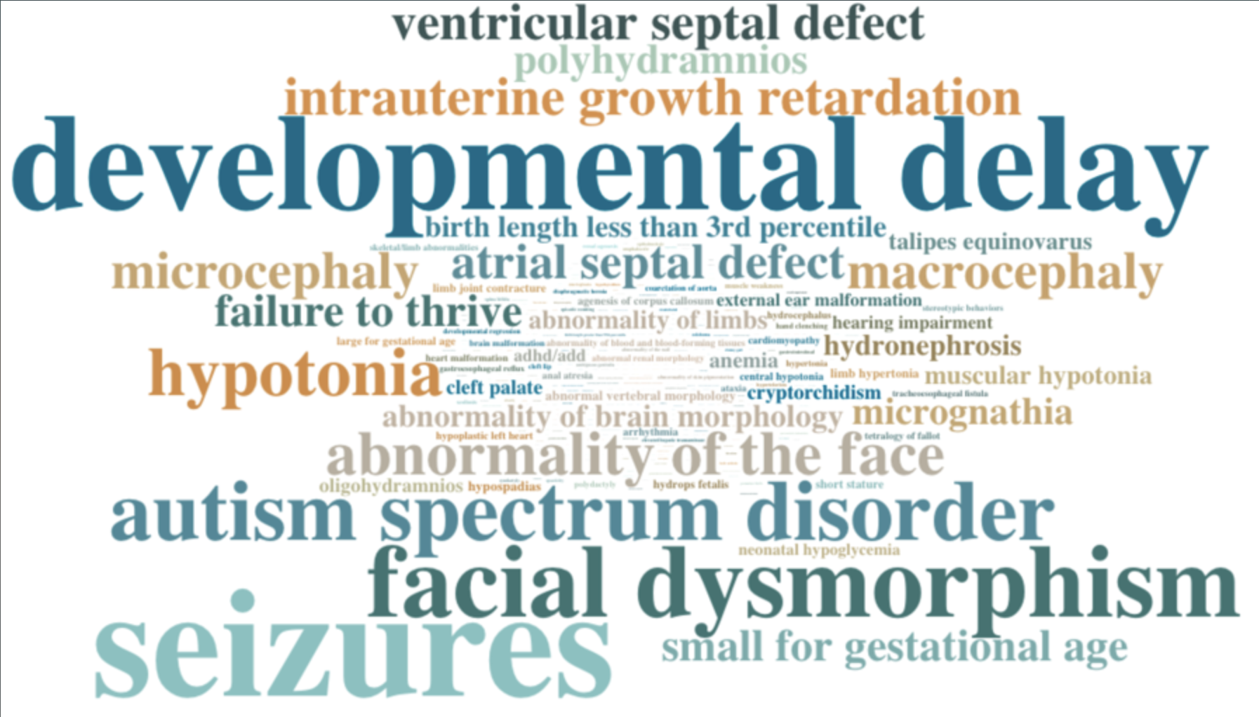
Neurodevelopmental Disorders (NDD)s
Seizures
Developmental Delay
Intellectual Disability
Motor Disorders
Limb and Facial Differences

Slide 17
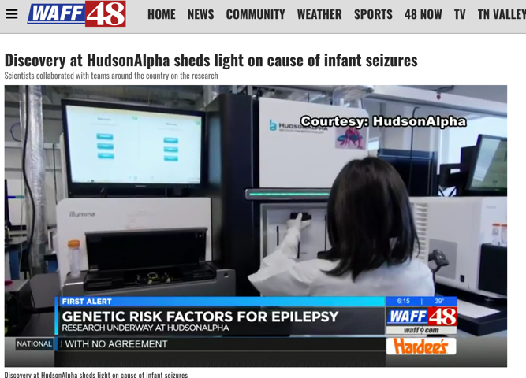

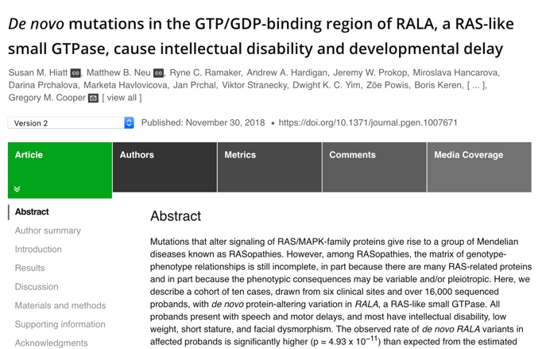
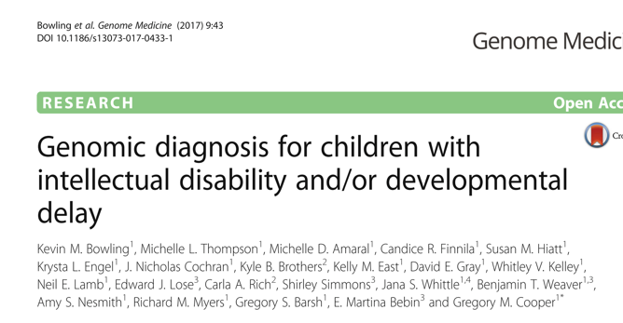
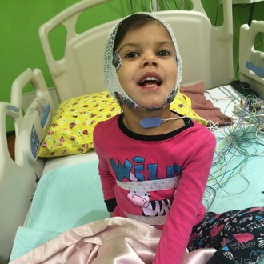

Why?
Genomic Diagnoses can:
End family’s “diagnostic Odyssey”
Increase access to services
Inform treatments
Link disease (symptoms) to specific gene(s)
First step to learn disease biology

Slide 18
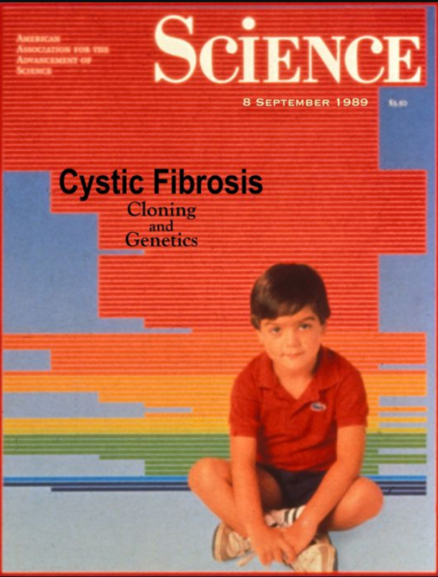
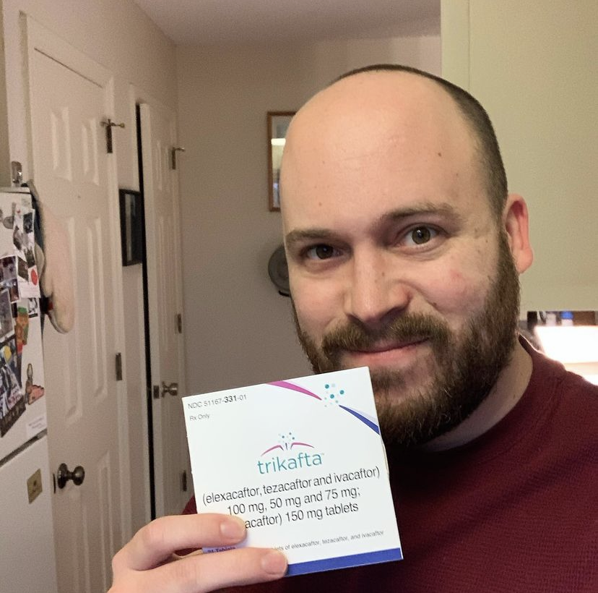
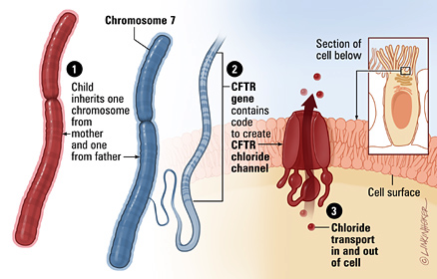
Disease-gene relationships are critical to scientific advancement & treatment
1989
1990s-2000s
2019
Notes:
But first I want to pause and reiterate why this basic science that does the work of linking new diseases to genes is so important. In my own life as a CF patient, I’ve been able to witness the direct impact of knowing precisely how a congential disease is affecting the patients on a genetic and molecular level. CFTR, the causative gene for Cystic Fibrosis, was found in 1989, and we eventually learned that it encodes a chloride channel whose malfunction causes the thick mucus that is the hallmark of this disease. This understanding has been critical to a majority of the treatments that I use every day. And that’s why

Slide 19
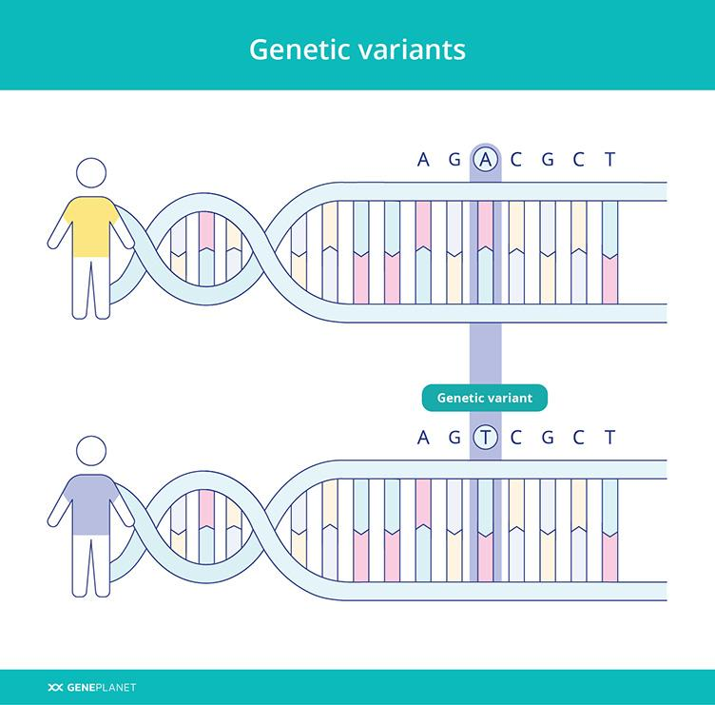

Slide 20
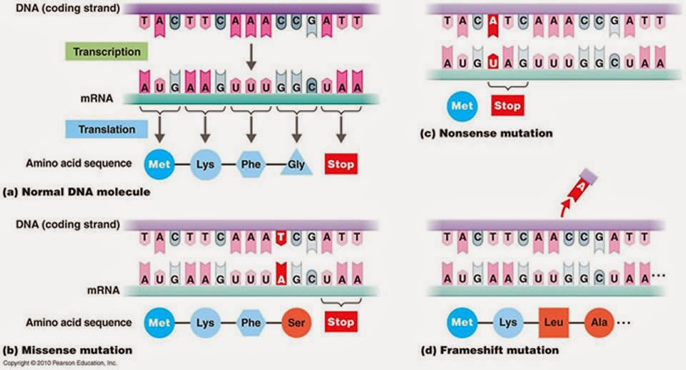
Best-understood variants alter proteins

Slide 21
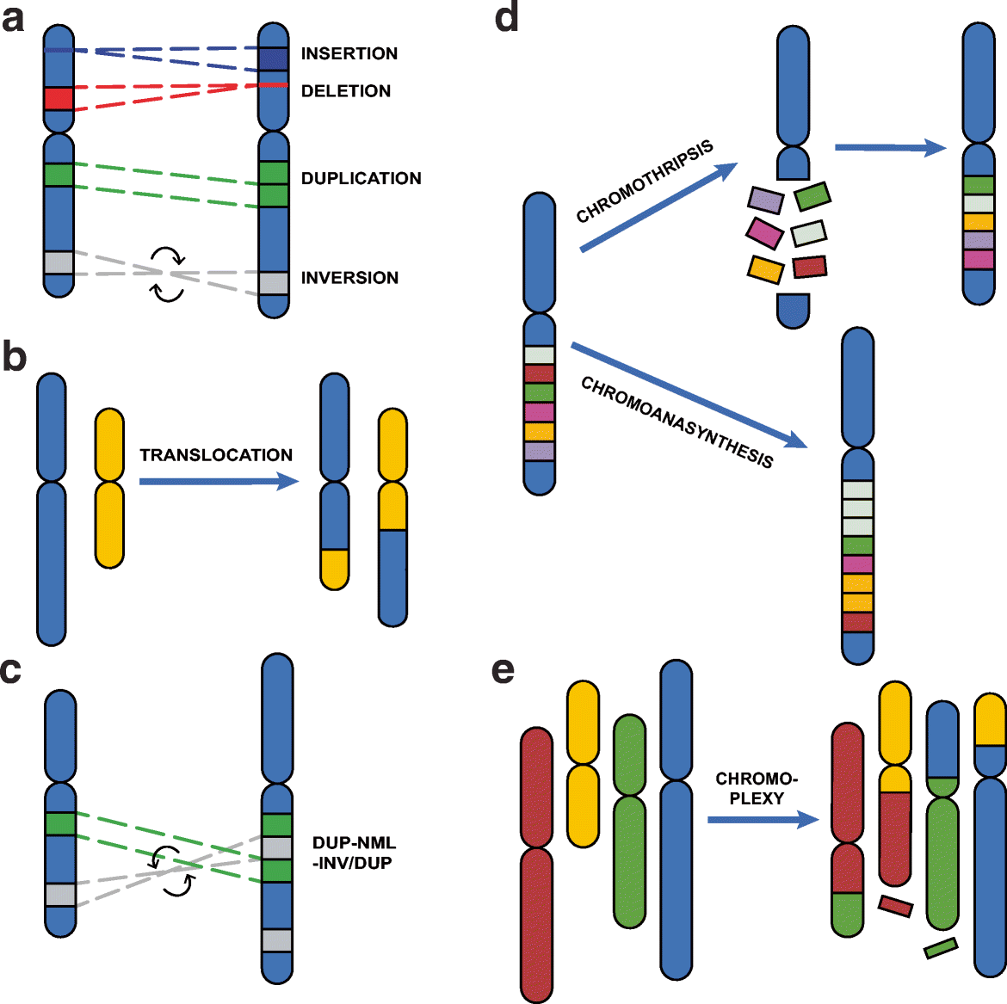
Structural Variants Cause Many NDDs
Balachandran, P., Beck, C.R. (2020)

Slide 22
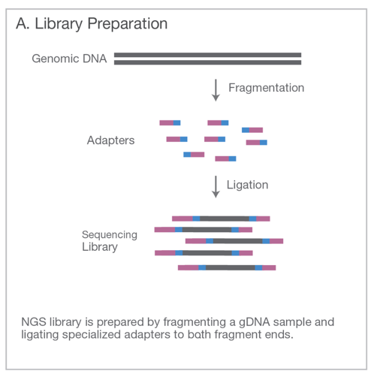
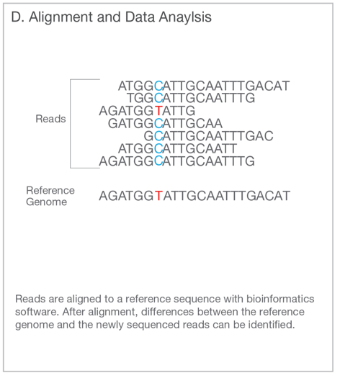
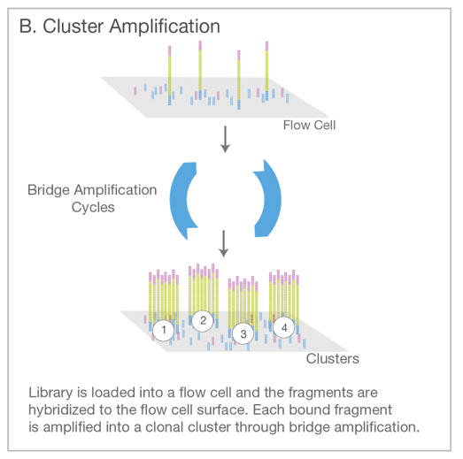
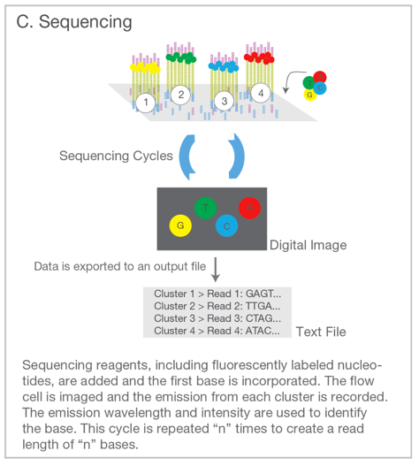
Genome Sequencing (Short Read / Illumina)
Illumina. An introduction to Next-Generation Sequencing. (2017).

Slide 23
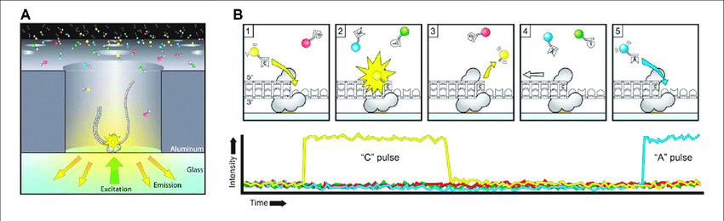
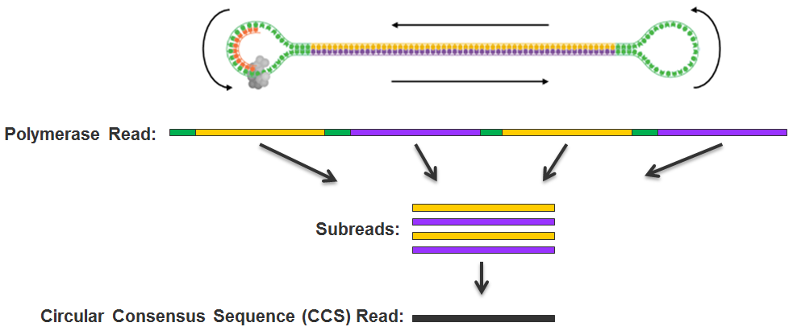
Long Read / PacBio

Slide 24
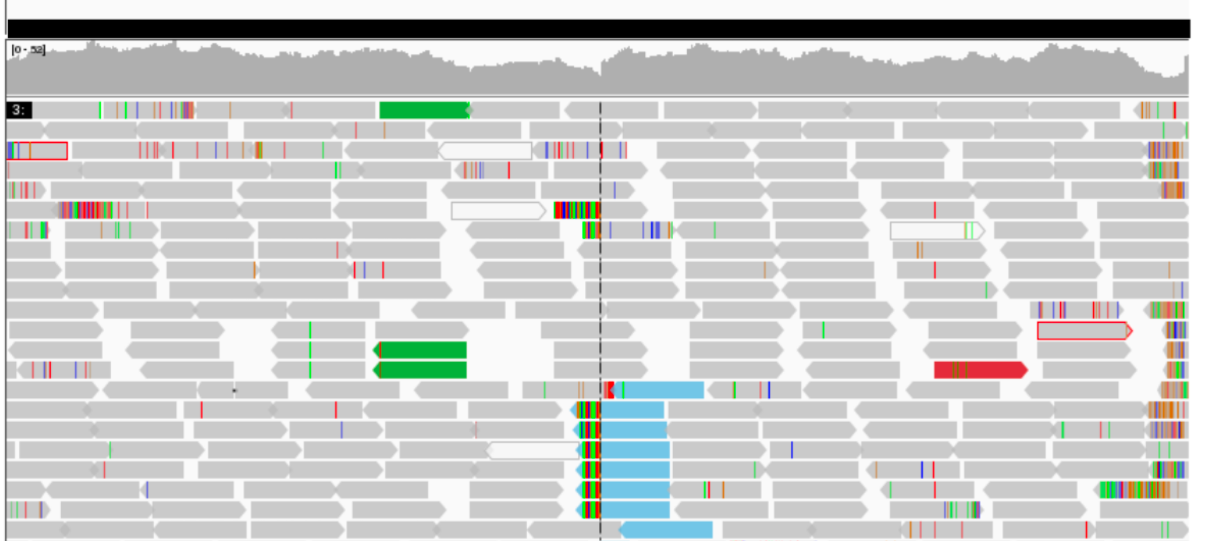
“Variant Calling” or “Genotyping”: Data -> Description
Align reads to reference genome
Find a pattern in suspicious reads
Sequence
Depth
Pairing
Calculate statistical likelihood
24

Slide 25
Filtering / Analysis / Interpretation is key
population frequency
genomic annotations
computational predictions
inheritance pattern
clinical disease databases
phenotypes
published literature
~4,000,000 variants
~1 causal variant
We evaluate the totality of existing evidence for a particular variant

Slide 26

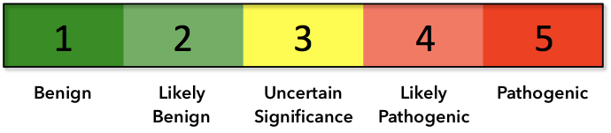
Assess Evidence
Population Frequency
Inheritance
Computational Evidence
Patient’s Phenotype
Variant Type
Previously Reported
Functional Assays
Clustering in a functional domain

Slide 27
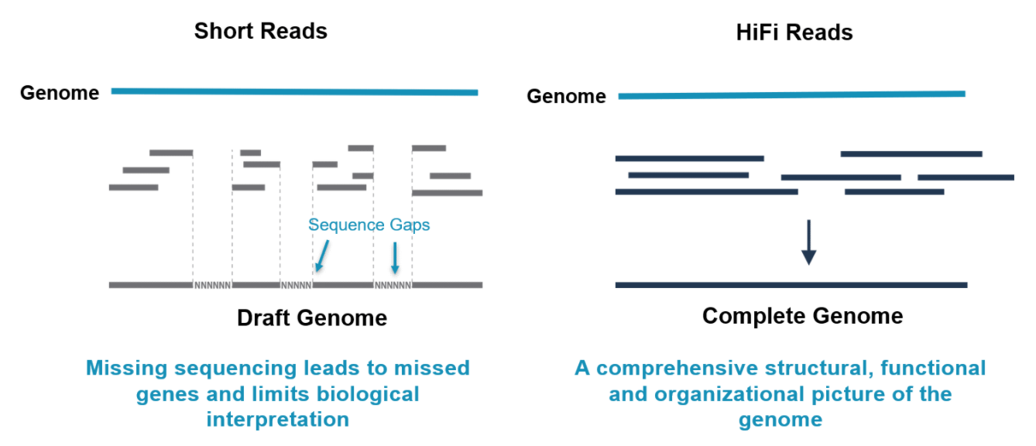

Benefits of Long-Read sequencing
(150 bp)
(10,000-20,000 bp)
Longer reads 🡪 better alignment to the genome 🡪 more accurate variant calling

Slide 28
Long Read SV Examples

Slide 29
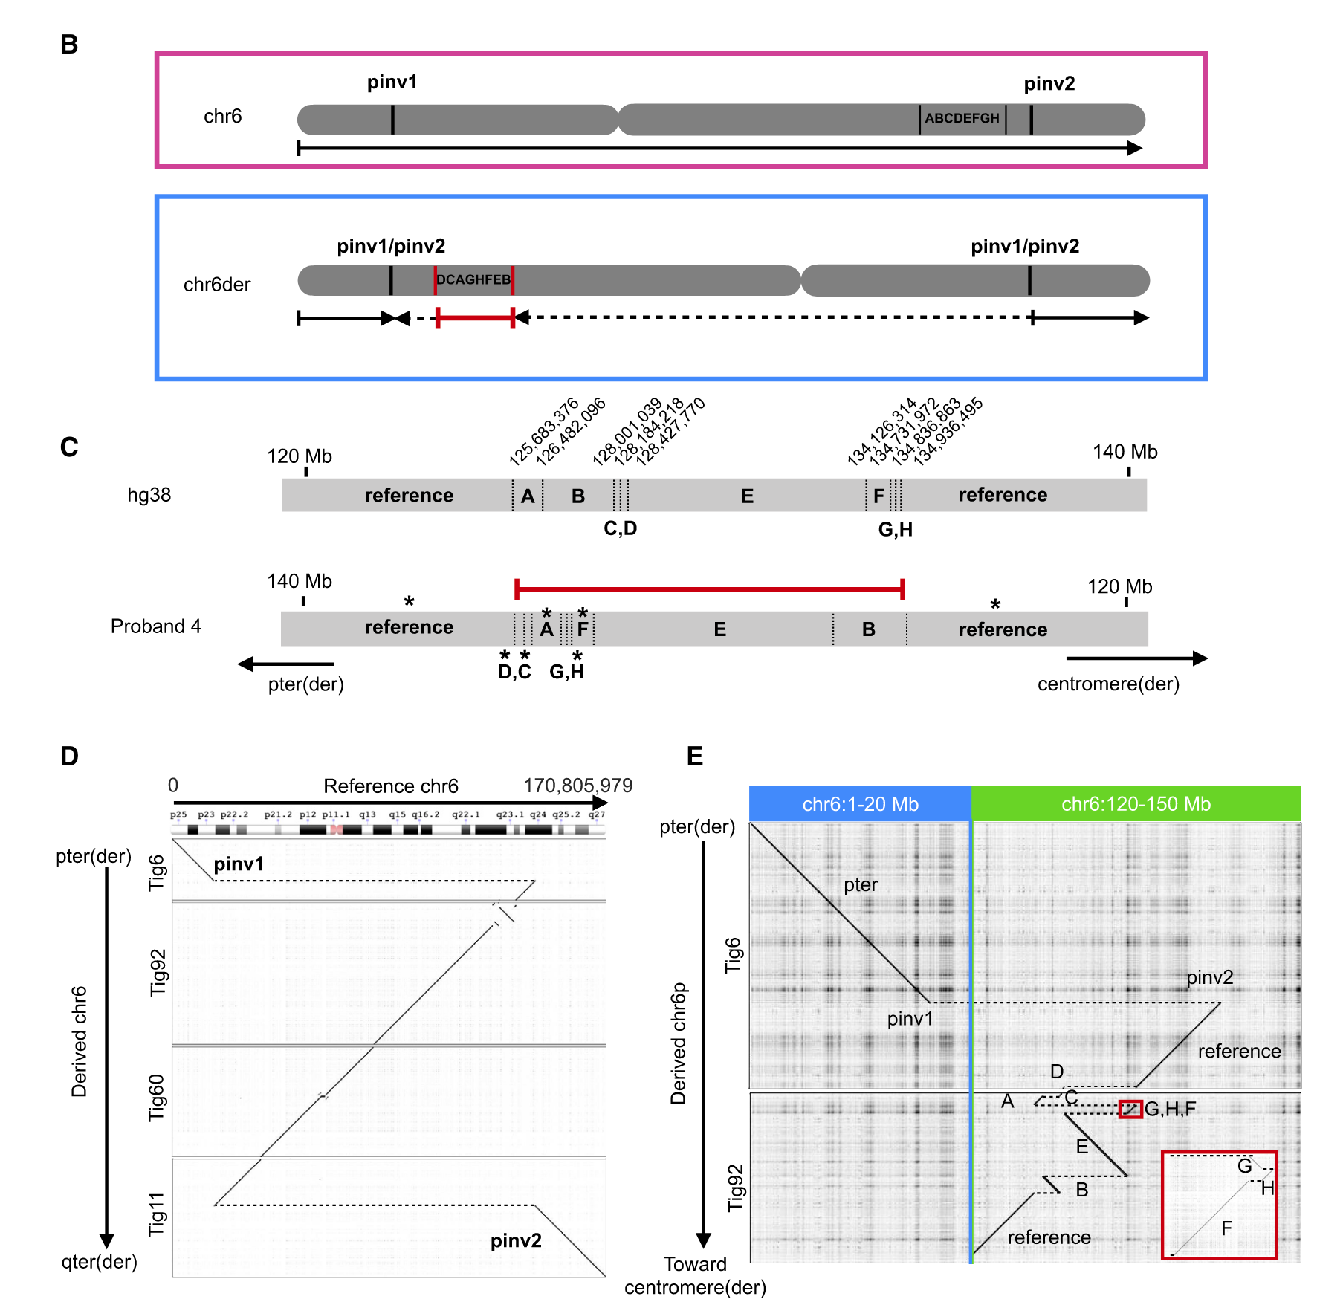
Hiatt (2021)

Slide 30
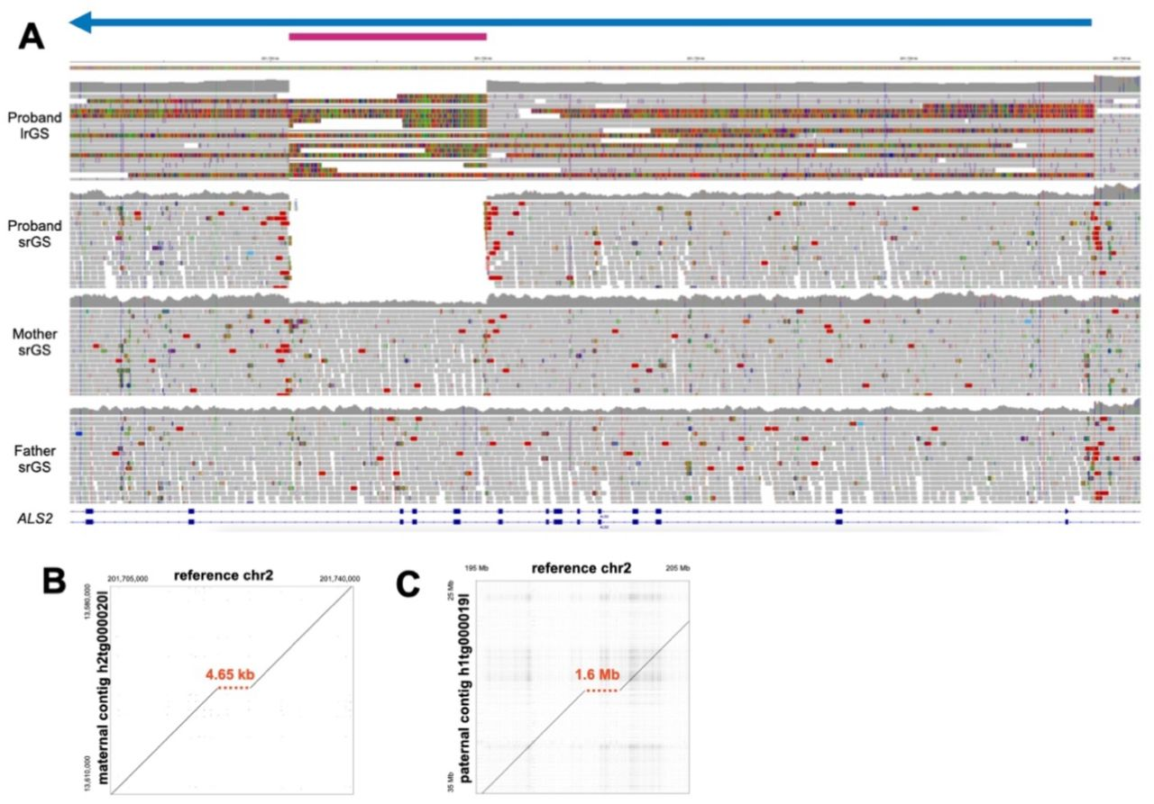
Hiatt (2023)

Slide 31
My Role

Slide 32
Computational Biology / Bioinformatics
Use computational tools
Programming
Mathematical models & machine learning
Databases
Physics simulations
To analyze huge sets of data
Genome sequencing
Protein modeling
And answer biological questions
How does this gene work?
Does this disease have a genetic pattern?
How are these species related?
What makes a liver cell different from a brain cell?

Slide 33


Slide 34
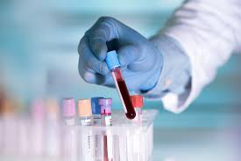
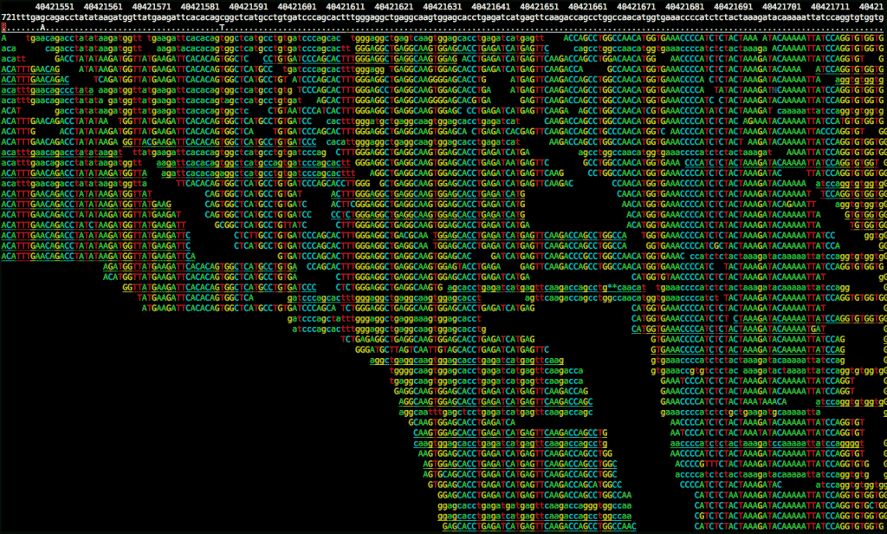

Picturing the Whole Process
34

Slide 35
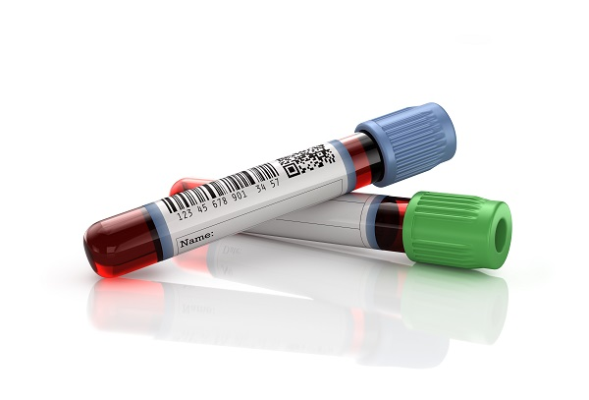
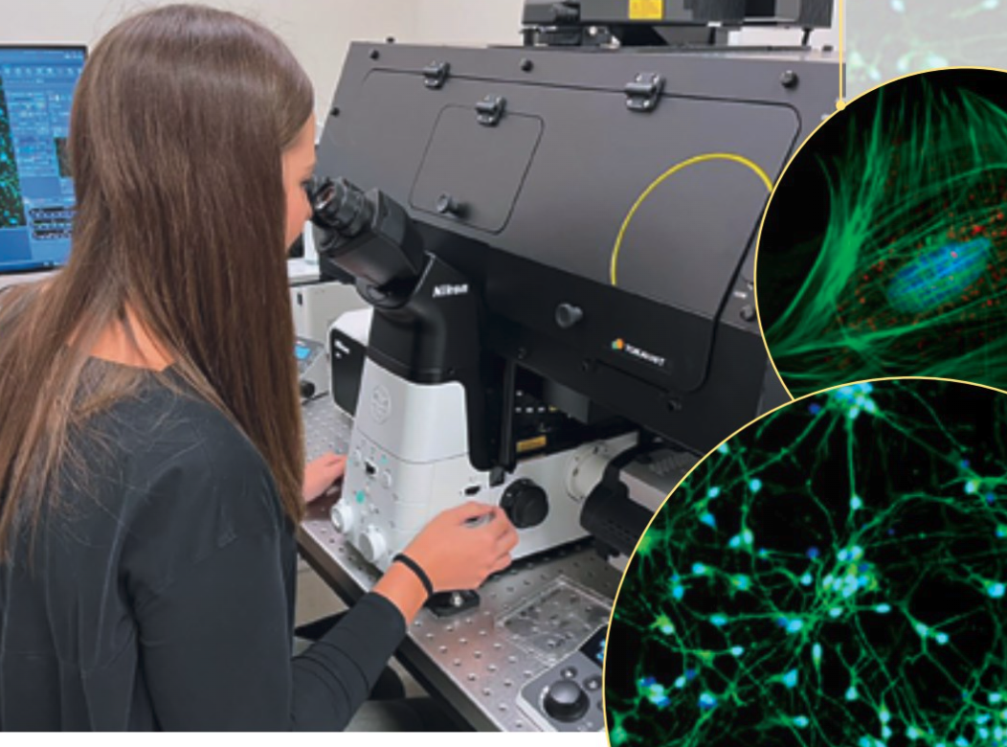
Sequencing
Variants
Ref & SW
Technology
QC + Accuracy
Sample
Type
ID codes
Conc.
Results
Patient
Symptoms
Diagnoses
Prior test results
Science
Ref Genome
Disease <-> Gene
Population variants
Func. predictions
Physician
Questions
Orders

Slide 36
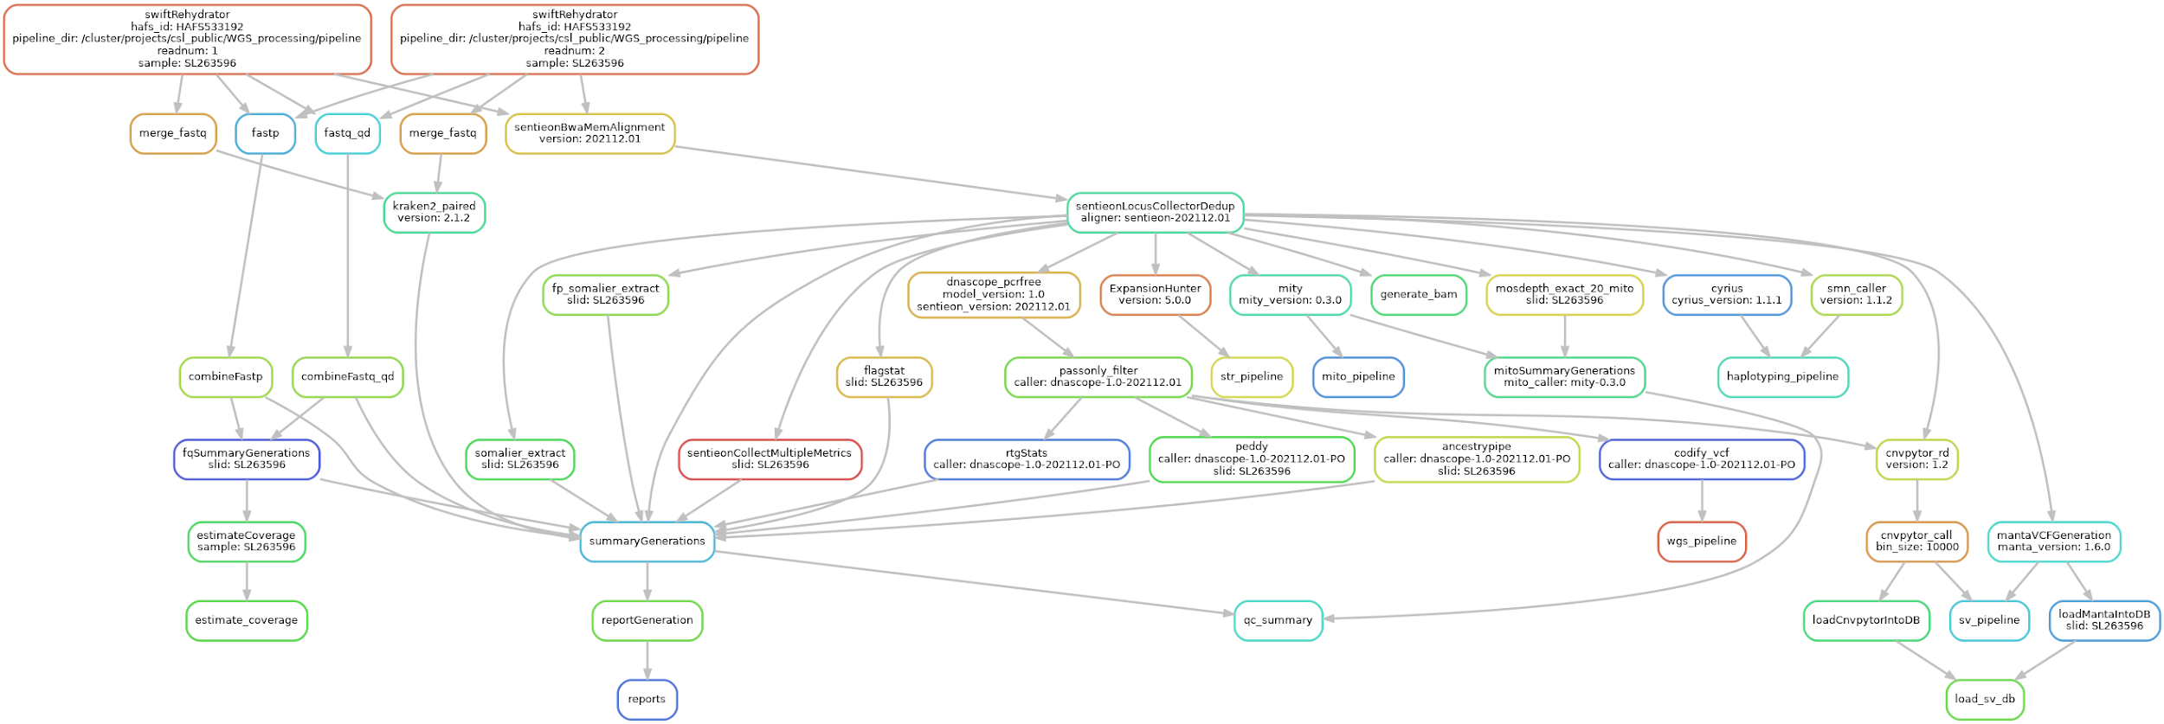
WGS Computational Workflow

Slide 37
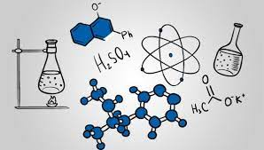



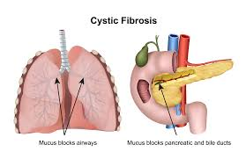


My Trajectory
High School
Web & SQL
Difficult -> felt boring
BS: Biochemistry & Math
Job: Tutoring & Higher Ed.
Job: Missile Defense Cost Analyst
MS: Modeling & Simulation
Project: Cystic Fibrosis Genomics + Machine Learning
HudsonAlpha Computational Biologist
Programming as a tool to solve interesting scientific problems

Slide 38
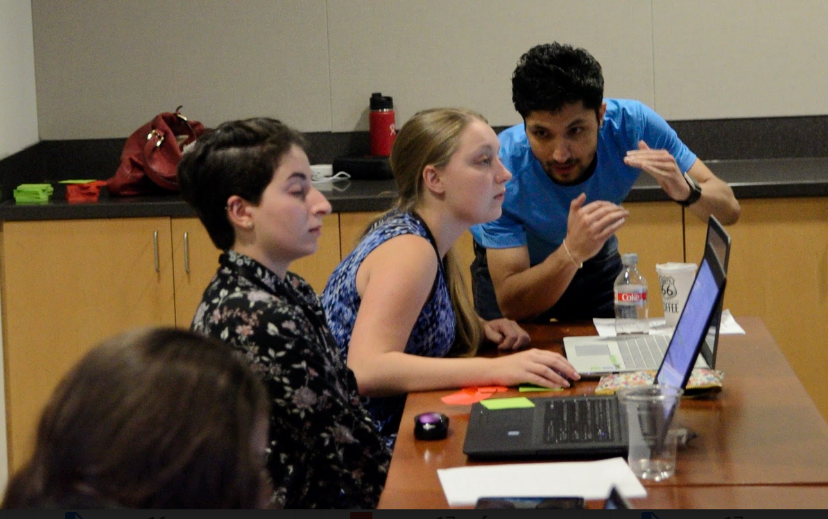
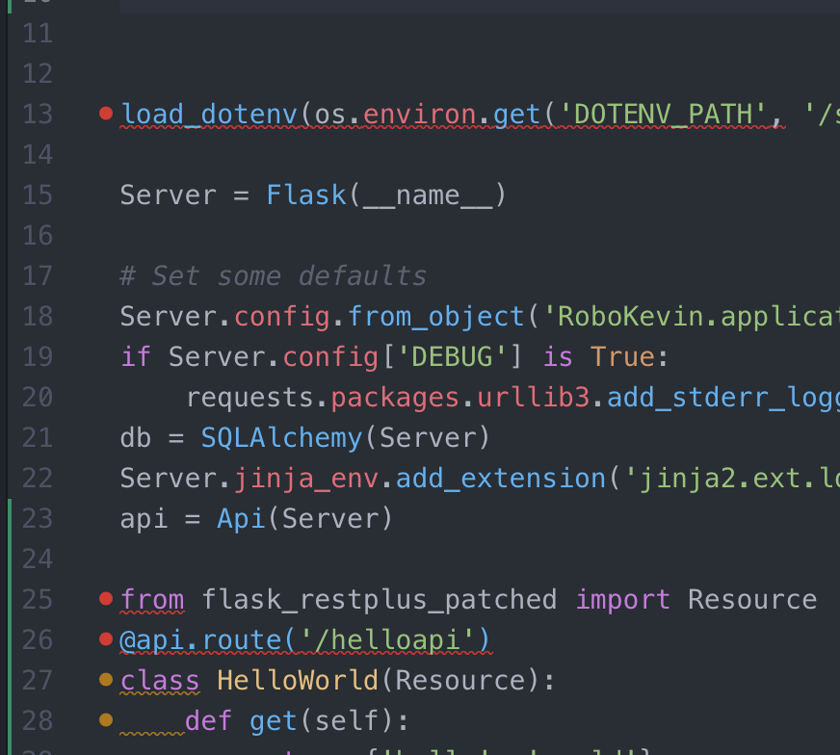

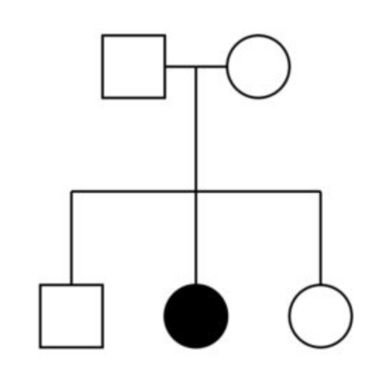
Critical Skills
Communication
Tech writing
Public speaking
Teamwork
"Translating"
Business Process
Automation
Documentation
Data management
Science
Genetics & Biochemistry
Statistics
Scientific Literature
Tech
Programming
Compute clusters
Unix
Troubleshooting
New languages & tools

Slide 39
Summary
Genomic diagnoses benefit families with NDDs
Long-read sequencing can help identify more structural variants causing NDD
Computational expertise needed at many points in the process

Slide 40
Bootcamp Intro

Slide 41
Goals
Introduce computational biology through:
Discussion of real-world need for computational skills in genomics
Hands-on lessons from the Software Carpentry in R & Unix Shell
After today, we will be able to:
Navigate files and folders on a Unix system
Create, copy, move, delete, and find files and folders
Record work in a computational lab notebook
After tomorrow we will be able to:
Read and manipulate data in the R programming language
Use programming concepts in R: Functions and For Loops *
Know where to learn more and how to ask for help

Slide 42
Flow
Discuss concepts -> work exercises -> review together
Website has links to reading/example material: http://james-lawlor.github.io/biotrain-2024
Asking questions = better experience for everyone
Live feedback with post-its:
Green post-it on computer: The pace is good and I’m keeping up
Red post-it on computer: I’d like a helper / Slow down!
Helpers: Experienced helpers are available for one-on-one help as we’re working

Slide 43
Why learn Unix and R?
Unix lets us access high-performance computing environments and industry-standard software
Easy way to introduce fundamental concepts about programming and computers:
Let the computer do the work for you instead of repeating yourself
Save your “program” so you can re-use it later
Learn to combine small tools into a more complex behavior
Learn to troubleshoot problems (of any kind)
A little hands-on experience goes a long way

Slide 44
Windows Gotchas
We will use the program Git Bash to access the Unix shell
Copy & Paste:
On windows, you are used to ctrl+c and ctrl+v to copy and paste. This will not work in Git-Bash window because ctrl+c and ctrl+v have different meanings in Unix
To copy:
Select text in the git-bash window with the mouse, and it will automatically be copied
Or, use the right-click menu
Use ctrl+insert (some laptops may not have this as a separate key)
To paste:
Click with the middle mouse button
Or, use the right-click menu
Use shift+insert (some laptops may not have this as a separate key)
Git-Bash represents Windows-style paths (with backslashes, \), like C:\Users\James, in the Unix style (with forward slashes, /), like /c/Users/James
The ls command should work on Git-Bash, but if not, use dir

Slide 45
Mac Gotchas
We will use the program Terminal to access the Unix shell
Everyone on mac, together let’s open terminal and type bash to make sure we’re set up correctly
If you’re used to Windows Control+C and Control+V remember that Mac uses Command+C and Command+V
Command-C and Command-V work as usual in Terminal
1. A few years ago, MacOS changed the default shell to `zsh` instead of `bash`. The two are similar, but for clarity we will use bash.
2. Open the Terminal app
3. At the prompt, type `bash` and hit enter. Make sure to do this every time you open the terminal.
4. If you want to change your default shell to bash, so that you don't have to type the bash command every time you use terminal, follow steps 5-8.
5. At the prompt, type `chsh -s /bin/bash` and hit enter. You should see "changing shell for <username>"
6. You will be asked to enter your password, then hit enter. If there are no errors, you will be back at the prompt.
7. Close Terminal and then re-open. You should see in the title bar of the window that it says "Terminal -- -bash"
8. **Note**: This change will persist for your user profile. If you want to change it back after the bootcamp, you will use the command `chsh -s /bin/zsh`

Slide 46
~ 10 minute Break

